Slide 1

Can we predict drunk case?
Ezgi NAZMAN

Slide 2
Methodology
PostgreSQL
Feature Engineering & ADASYN Sampling
Comparison of Machine Learning Methods

Slide 3
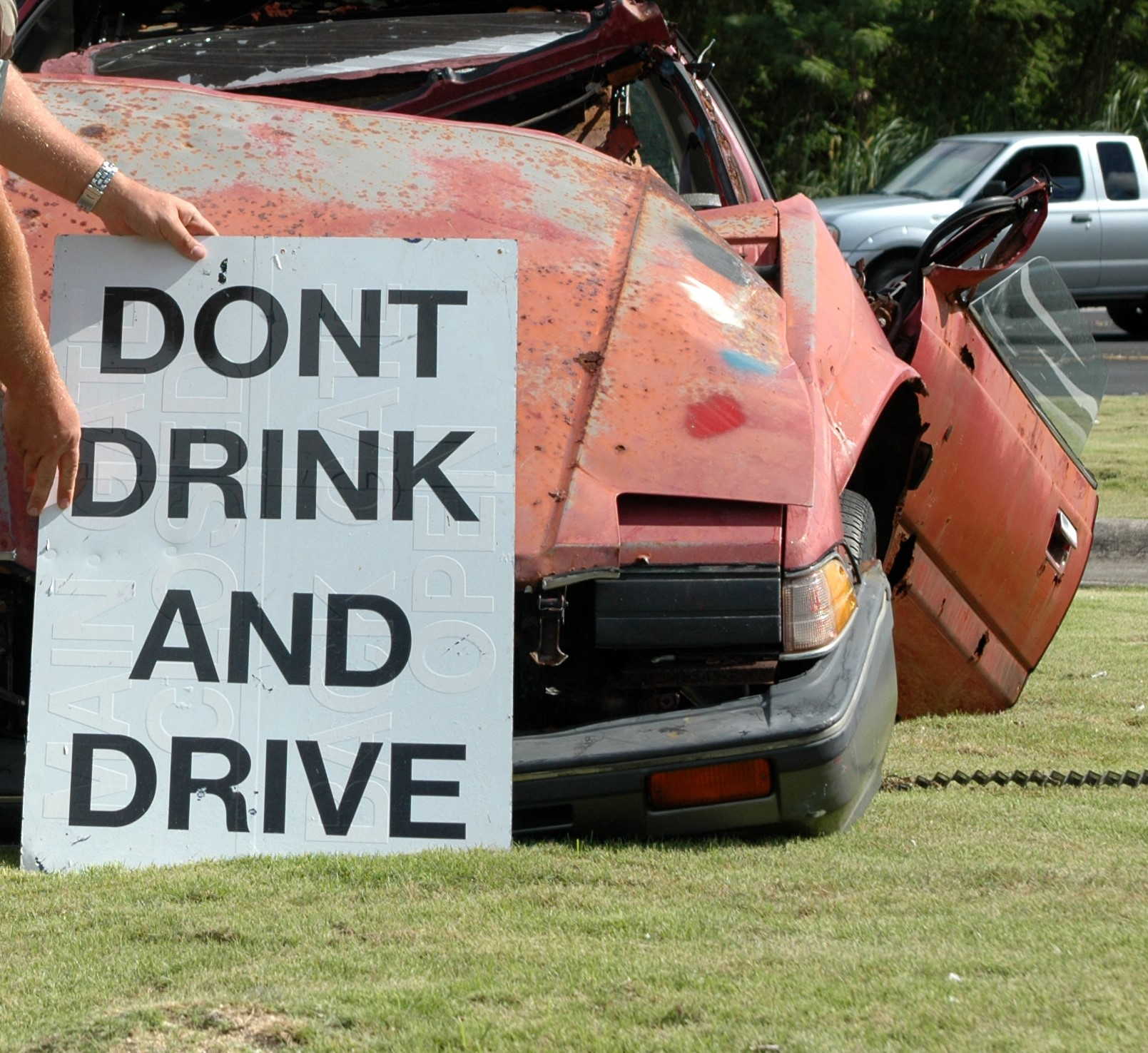
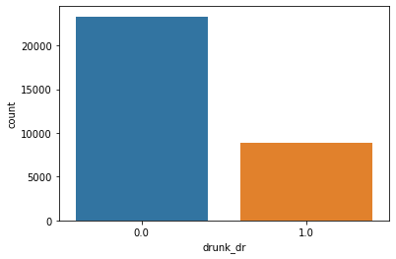
Group Label

Slide 4
FEATURES
ve_total | Number of Vehicle Forms Submitted | route | Route Signing
ve_forms | Number of Motor Vehicles in Transport | harm_ev | First Injury or Damage of the Crash
peds | Number of Forms Submitted for Persons Not in Motor Vehicles | man_coll | Manner of Collision
pernotmvit | Number of Persons Not in Motor Vehicles in Transport | typ_int | Type of Intersection
persons | Number of Forms Submitted for Persons in Motor Vehicles | rel_road | Relation to Trafficway
county | County | lgt_cond | Light Condition
day | Day | weather | Weather
month | Month | tow_veh | Vehicle Trailing
day_week | Day of Week | vtrafway | Trafficway Description
hour | Hour of Crash | vnum_lan | Total Lanes in Roadway
nhs | National Highway System | vspd_lim | Speed Limit
func_sys | Functional System | male_num | Male Frequency
rd_owner | Ownership | female_num | Female Frequency

Slide 5
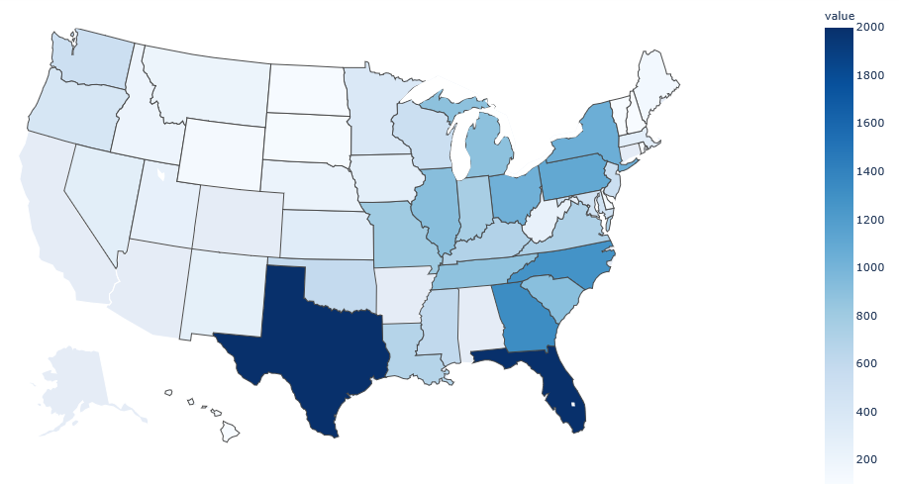
ACCIDENT DISTRIBUTION
Texas
Florida

Slide 6
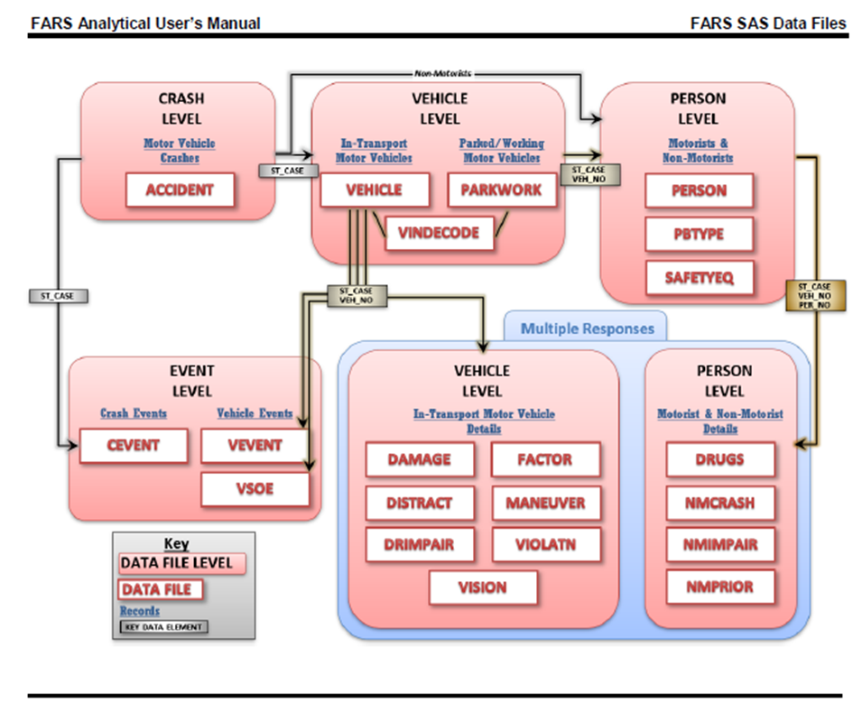
PostgreSQL Table Relations

Slide 7
Machine Learning Methods
Binary Logistic Regression
Support Vector Machine
Gradient Boosting
Bagging Decision Tree
Random Forest
Extra Tree
AdaBoost
Stochastic Gradient Boosting
Voting Ensemble
XGBoost

Slide 8
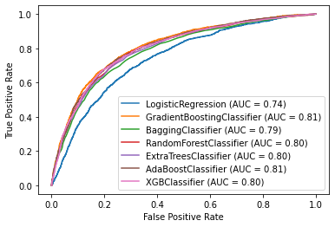
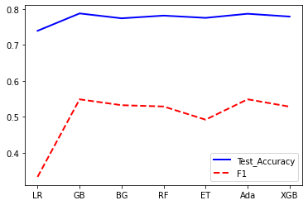
Results

Slide 9
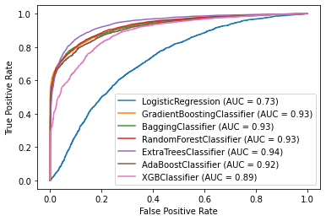
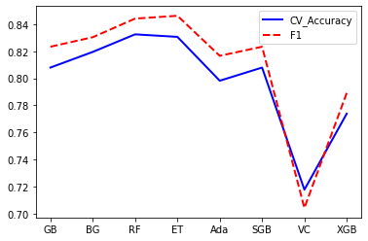
ADASYN Sampling Results

Slide 10
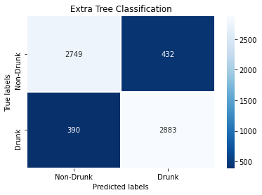
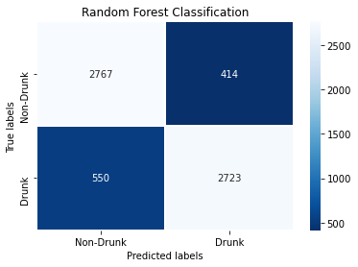
Confusion matrix?

Slide 11
Thank you!

